Slide 1
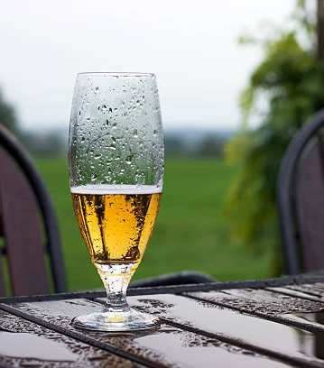
Daily POURcast A new web application created by Joe Dorau John Geipel Bryan Thusius Christian Livick

Slide 2
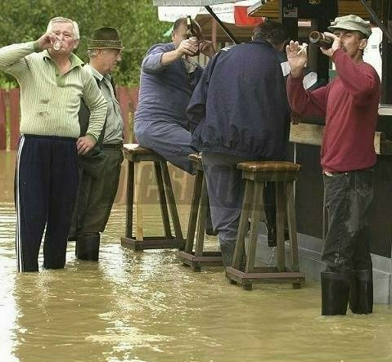
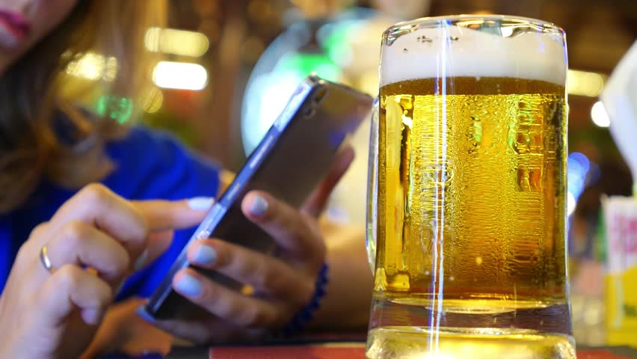
What is Daily POURcast?
Daily POURcast is an application that utilizes both the OpenWeatherMap API and Brewdog’s Punk API to recommend beers of various styles and potencies based on the weather in a user’s location.

Slide 3
Our Motivation
As avid beer drinkers ourselves, we are always looking for reasons to try new styles, brands, and pairings.
We also know that a good beer at the end of the day (or in the middle of the day) can help foster a sense of camaraderie with our fellow beer-drinkers through the discussion of mutual life stressors.
We asked ourselves, “what is a more common stressor than inclement weather?”
The answer is nothing.
For this reason, we decided to create something that would combine our love of new beers and our common distaste for crappy weather.

Slide 4

Design Process

Slide 5
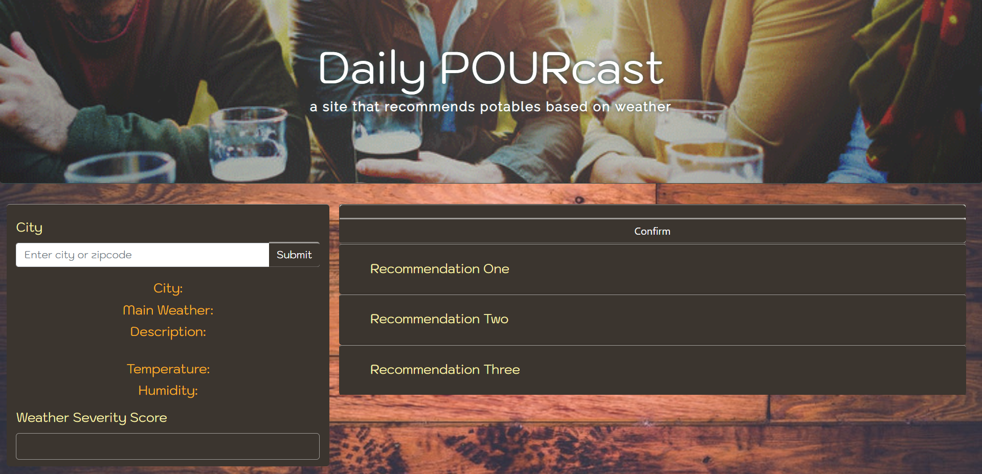
User Interface

Slide 6
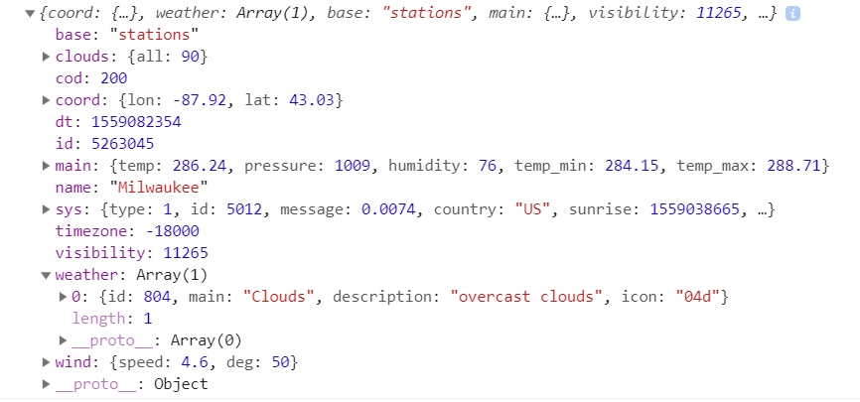
Sample JSON OpenWeatherMap

Slide 7
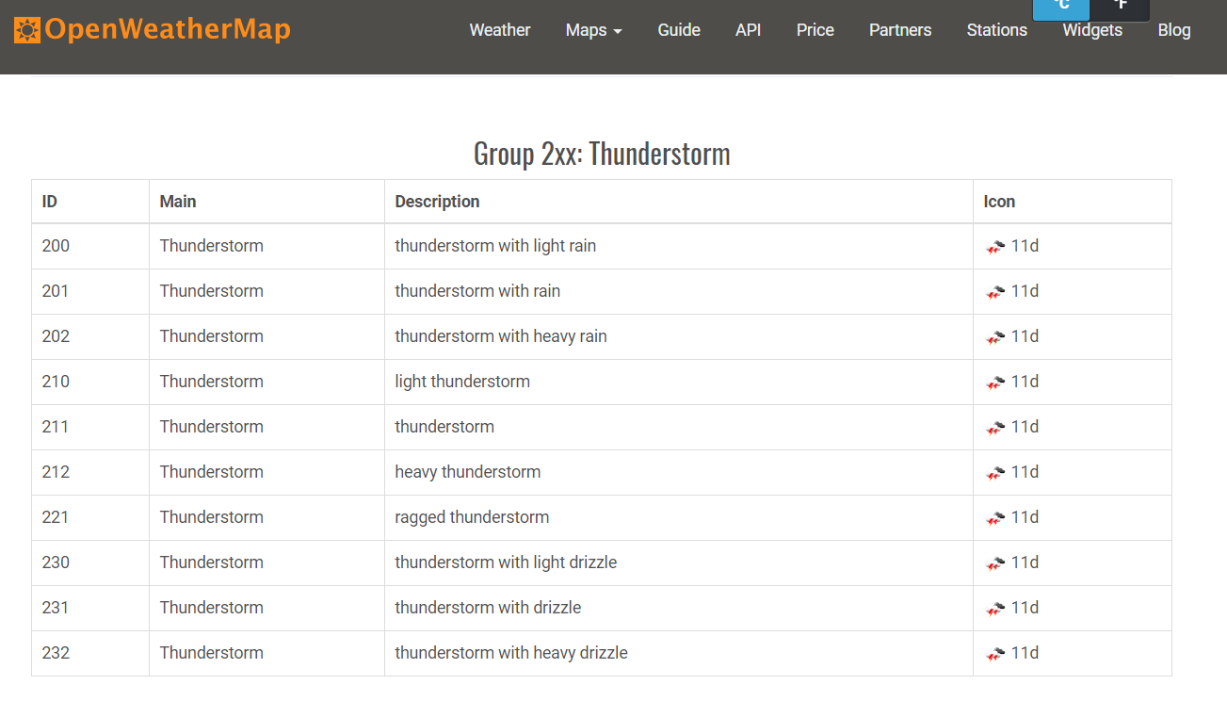
OpenWeatherMap API
Sample weather codes from OpenWeatherMap API

Slide 8
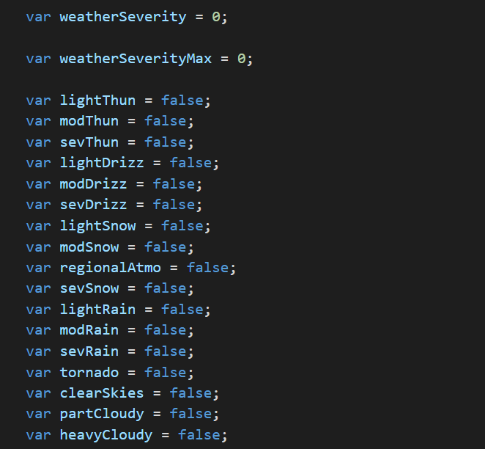
Variables to hold weather codes in different categories:

Slide 9
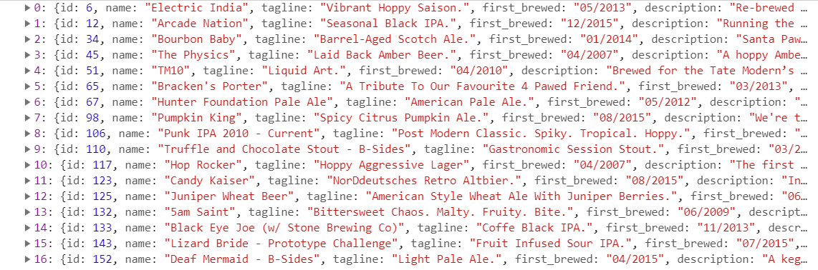
Example JSON from Punk API

Slide 10
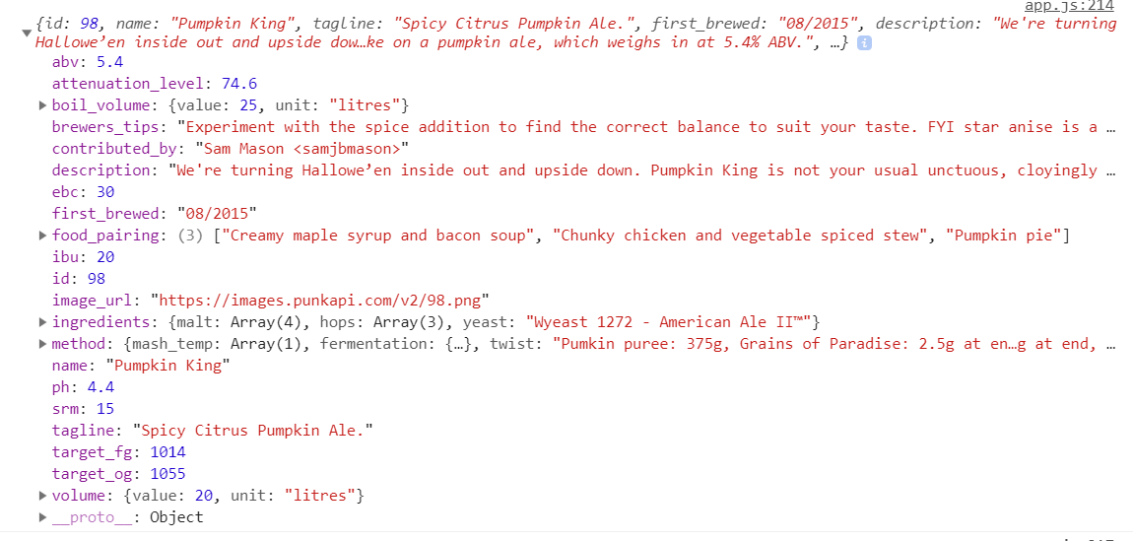
Example JSON from Punk API

Slide 11
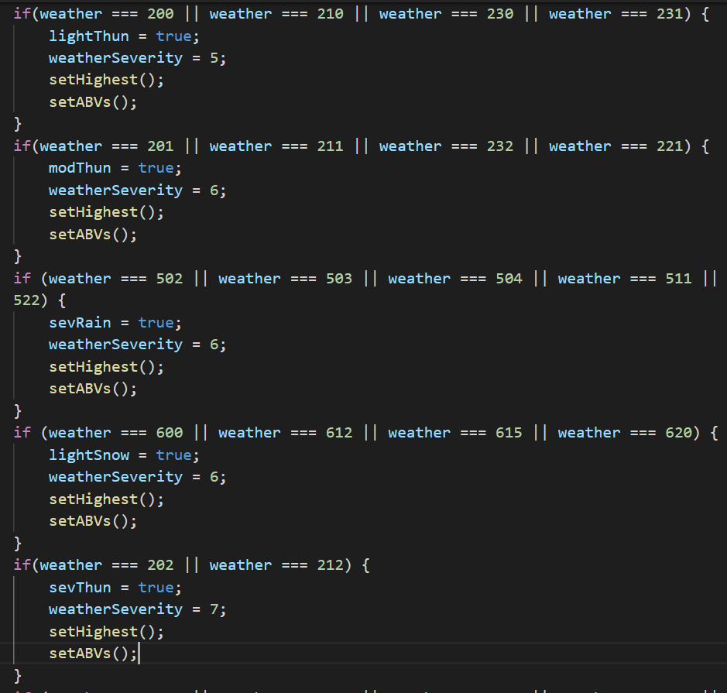
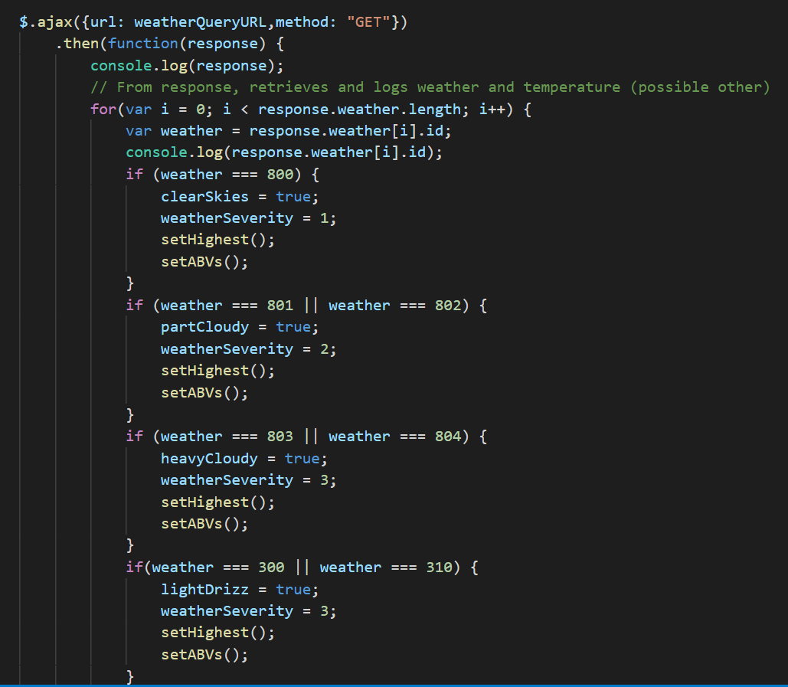
JavaScript (Cont.)

Slide 12
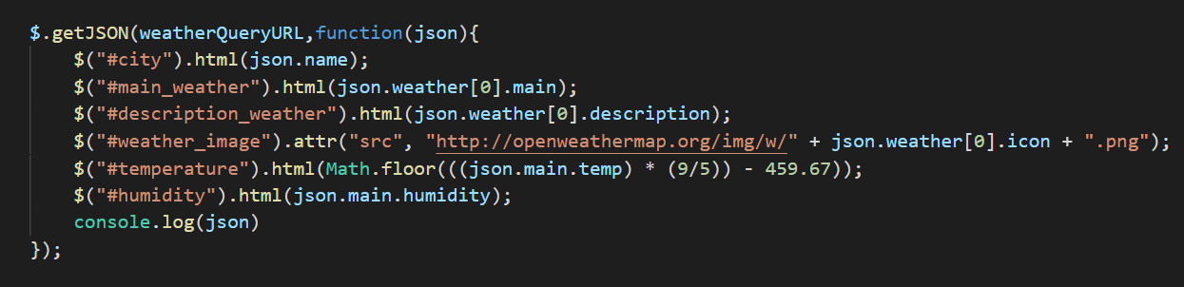
JavaScript (Cont.)
Updates DOM based on data retrieved from weather API (provides user with weather stats in their area)

Slide 13
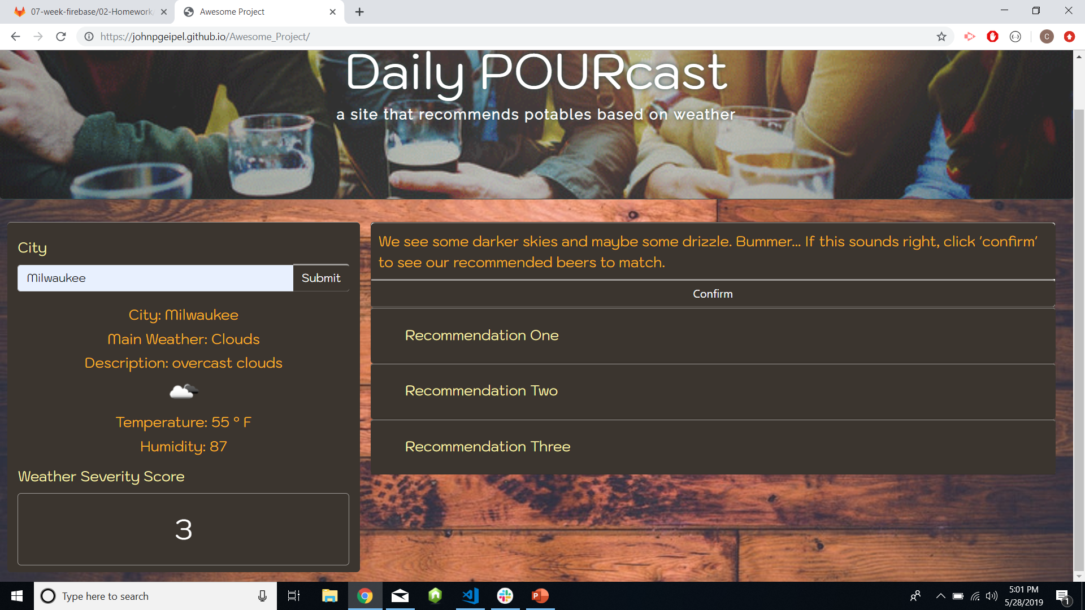

Example DOM Changes (weather stats)

Slide 14
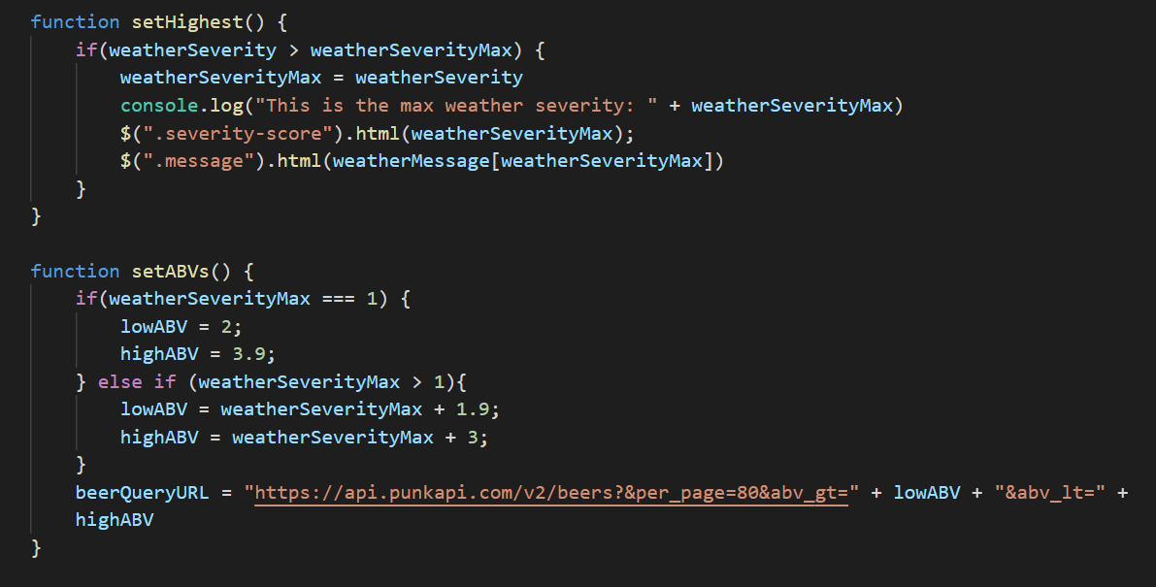
JavaScript (Cont.)
Determining level of weather severity
Setting abv range for ajax call from beer API

Slide 15
Example DOM Changes (weather stats)

Slide 16
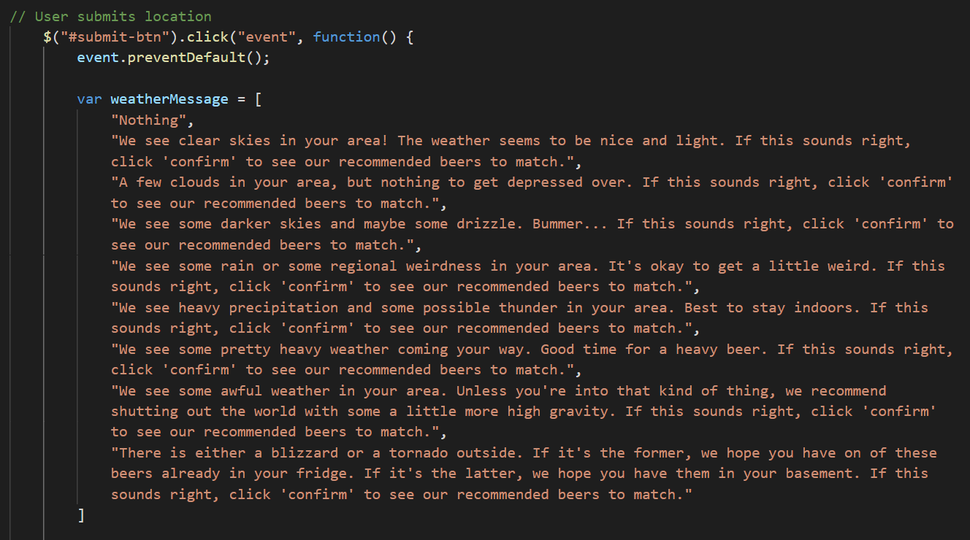

Slide 17
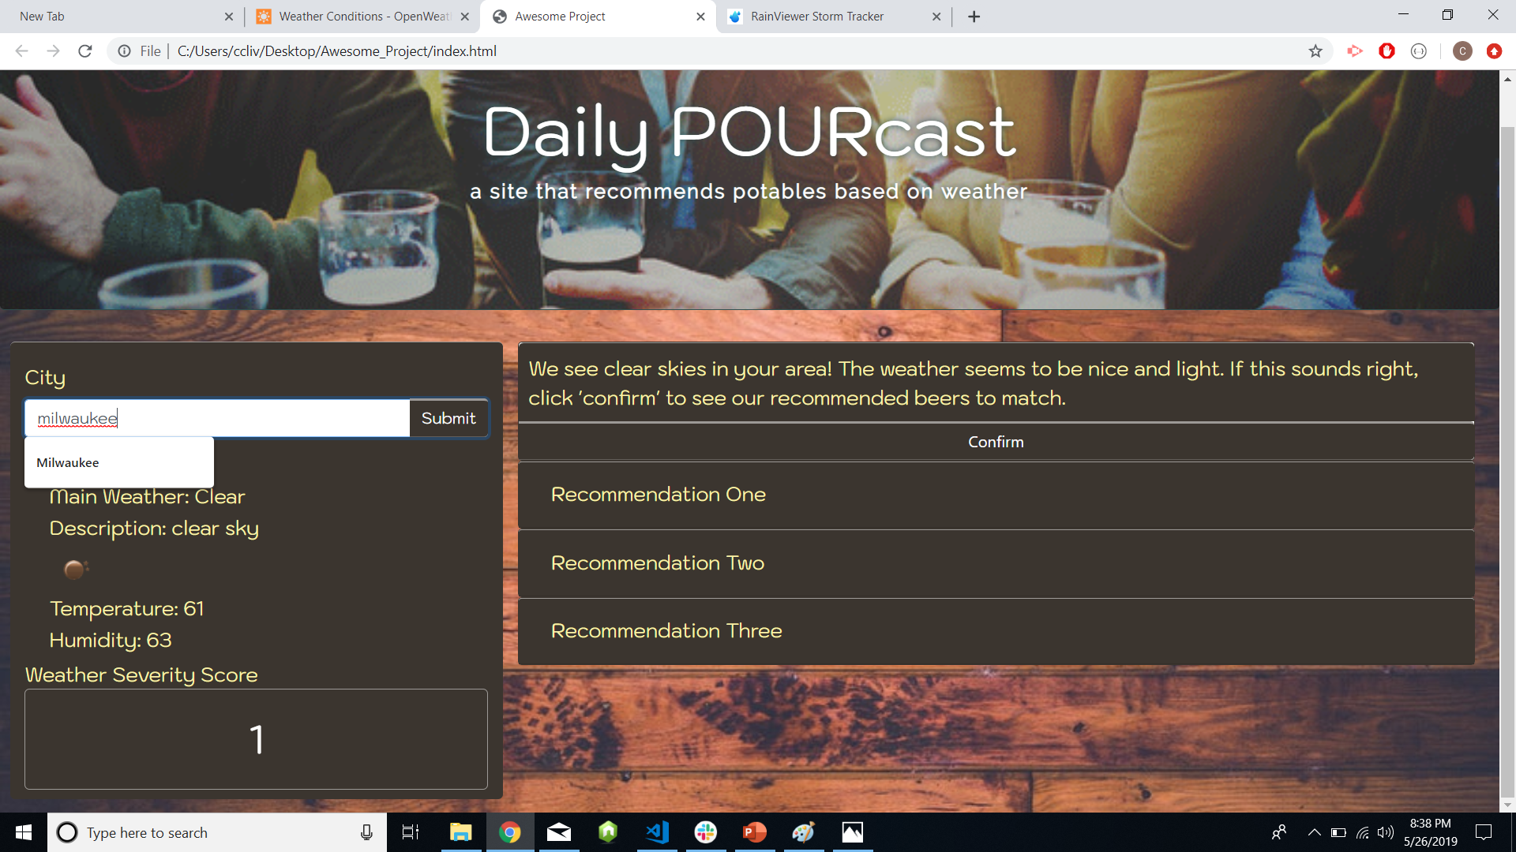
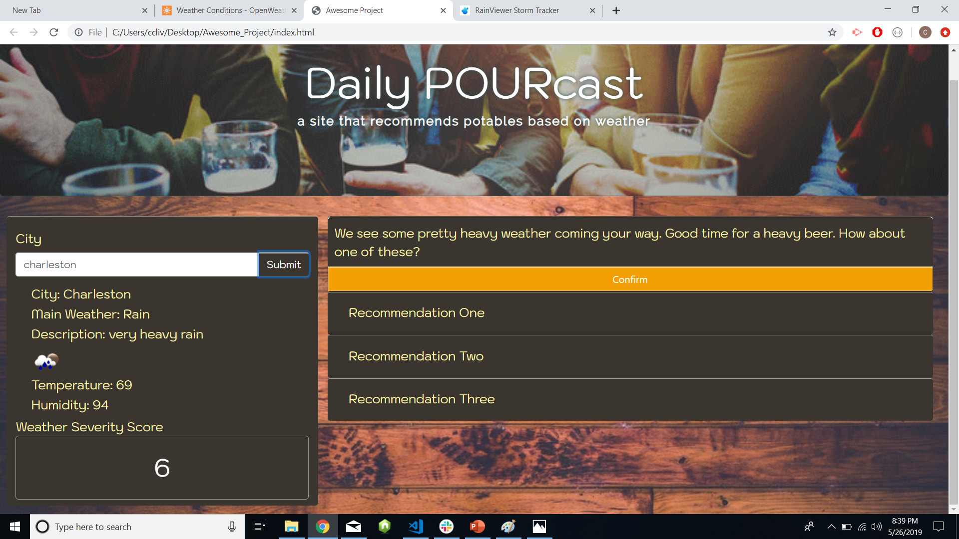
Example DOM Changes (weather message)

Slide 18
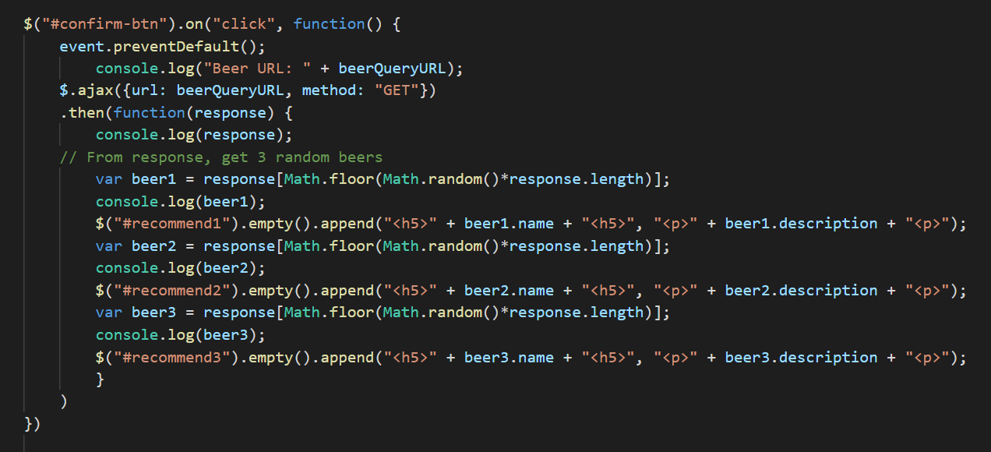
2 ^{nd} ajax call to Punk API

Slide 19
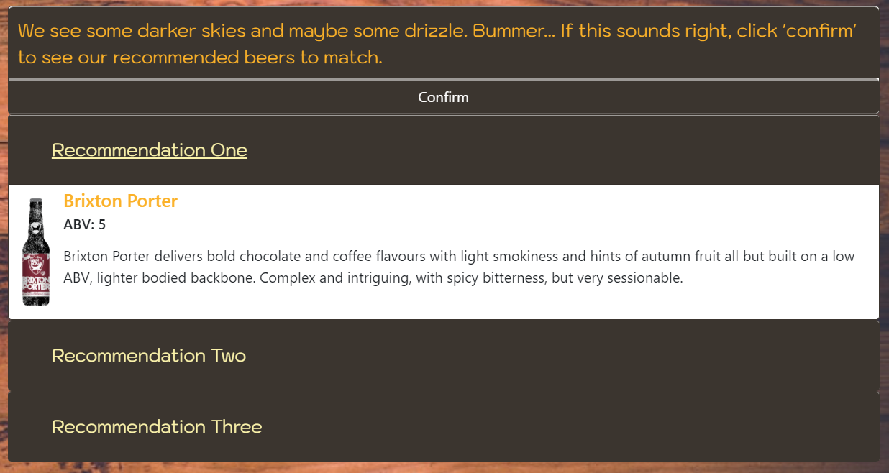
Example DOM Changes (Recommendations)

Slide 20
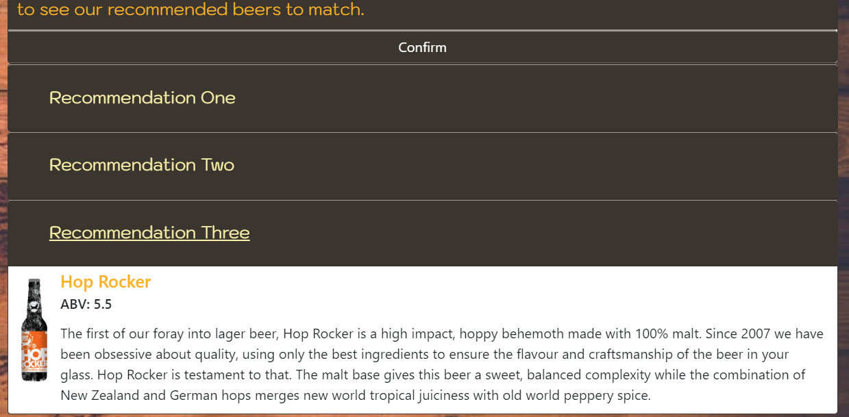
Example DOM Changes (Recommendations)

Slide 21
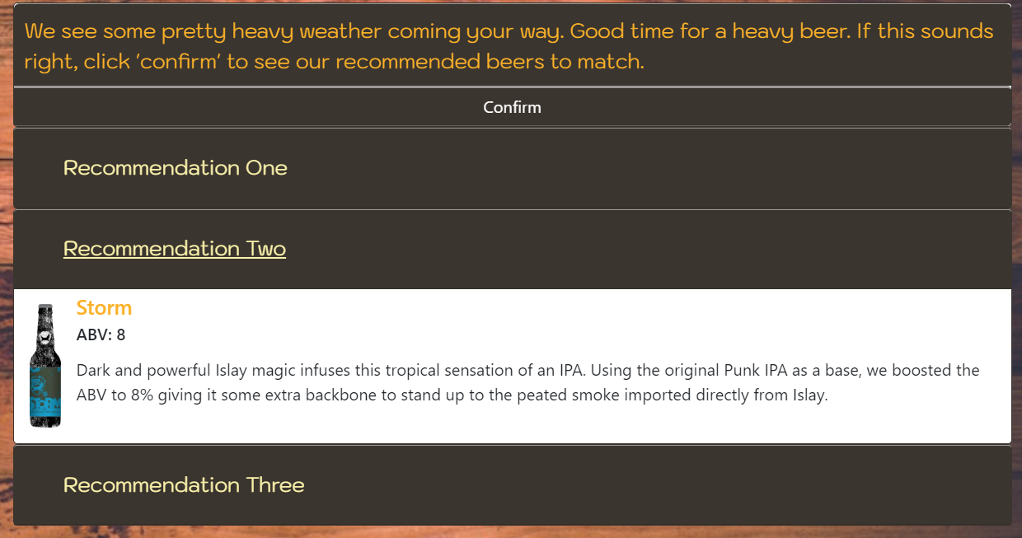
Example DOM Changes (Recommendations)

Slide 22
Future Development
Utilizing a more inclusive / expansive beer API
“Reasons to drink” Application
Additional pairings for new beers (besides weather)
Depressing News? (NYT, etc.)
Terrible Movie? (Rotten Tomatoes)
Annoying Date? (User Survey)
Possibilities: ENDLESS
Favorite Team Losing? (NBA Stats, Football Data)
Favorite Player Arrested? (NFL Arrests)

